Slide 1
POST INSTRUCTOR/MANAGER RESUME BUILDER WEBINAR
Julie Gorwood - Modular & PC 832 Coordinator
Rosanne Richeal - Basic Course Coordinator

Slide 2
QUESTIONS FROM EMAIL
1). Is there a way to download all current resumes into the resume builder?
No, they have to be individually built by the instructor and submitted to the presenter.

Slide 3
QUESTIONS FROM EMAIL
2). Can agencies (training managers) and academies
(administrators) help the instructors complete
their own resume?
The individual instructor is the only person who creates their resume in “Resume Builder”.
The presenter can provide direction or examples to the instructor to use.

Slide 4
QUESTIONS FROM EMAIL
3). Do presenters have the ability to edit and update an instructor resume?
Yes, presenters have the ability to edit an instructor’s resume. Resumes can be edited in Resume Manager and after the resume is attached to a course.
Editing a resume is made easier if the instructor has given permission to the Presenter by checking the “Can view my POST Profile” under the “Presenters” tab.
Notes:
Note: Any changes made to an instructor resume in Resume Manager will stay in the manager unless sent to the course. Changes made to a resume inside a course will not change a resume in another course.

Slide 5
QUESTIONS FROM EMAIL
4). Should I put all of my instructor information on a single resume?
Instructors should build a resume based on the course they are going to teach.
They can build a master resume and then copy that resume to create a new tailored resume to a specific course.

Slide 6
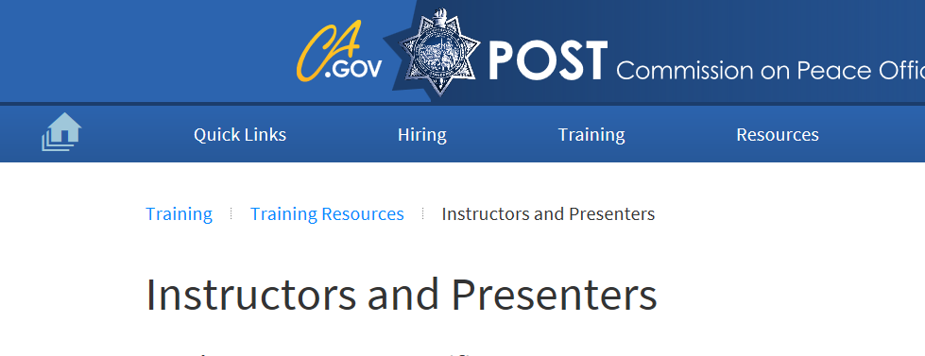
LINKS TO RESUME BUILDER
Option 1:
Click or hover over the “Home” icon. Under POST Sites
Option 2:
Click on “Training” tab, select “Training Resources” tab, select “Instructors and Presenters”. Scroll down until you see ‘Instructor Resume Builder”.

Slide 7
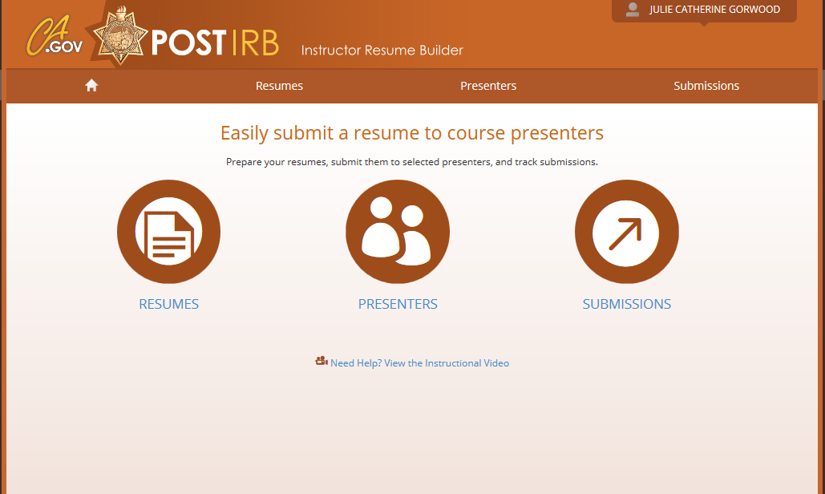
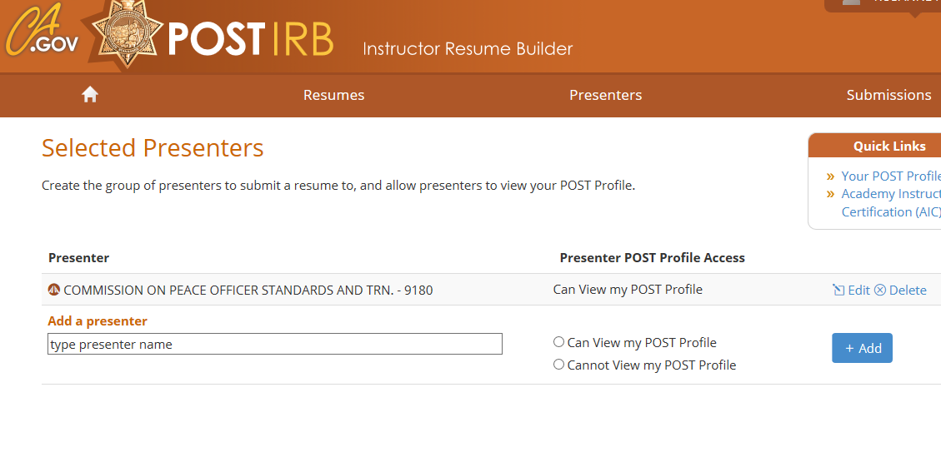
Step 1: Log into Instructor Resume Builder. Click on Presenters. Create a presenter in the “Add a Presenter” box. *You can only submit resumes to presenters in your list.
HOW TO CREATE A NEW RESUME

Slide 8
Step 2: To build your original instructor resume (Instructor Resume Builder). Click on “Resumes.”
RESUME BUILDER

Slide 9
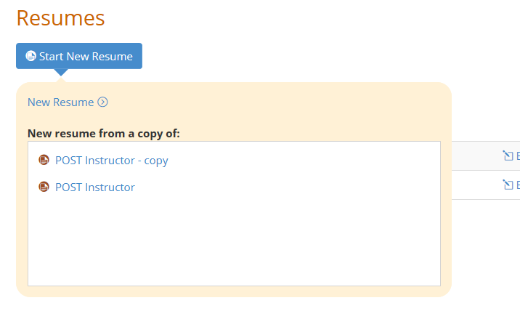
Step 3: Click on the blue “Start New Resumes” tab.
RESUME BUILDER

Slide 10
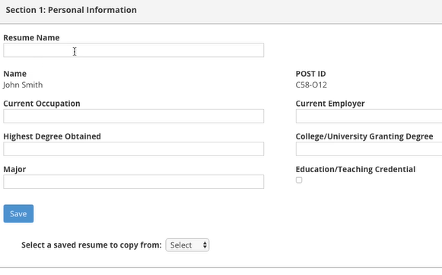
Step 4: Complete resume by filling in the boxes. Click the blue “Save” button. There are four sections for the instructor resume that need to be completed.
RESUME BUILDER

Slide 11
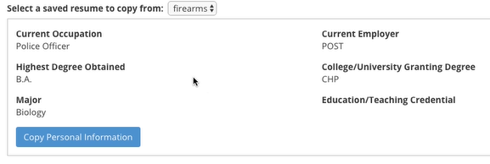
TIP: **Once you have created an initial instructor resume, resume information can be copied over by clicking on the “Select a saved resume to copy from” box only if there are other resumes listed.
RESUME BUILDER
Copying Information From Other Resumes

Slide 12
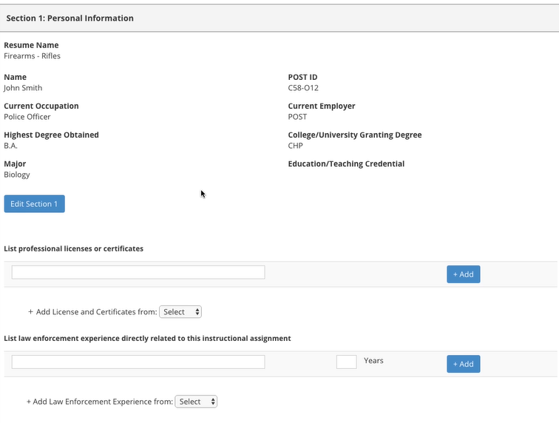
You can copy records one at a time from another resume by clicking on the drop down button. For this section, click “Add Licenses or Certificates” drop down box and then click “Add.”
RESUME BUILDER
Copying Information From Other Resumes

Slide 13
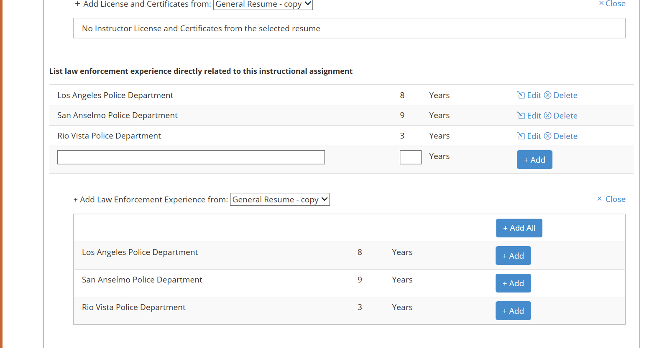
Select the resume to work from. This will open a window below with info from that resume. You can repeat this throughout the rest of the sections.
RESUME BUILDER

Slide 14
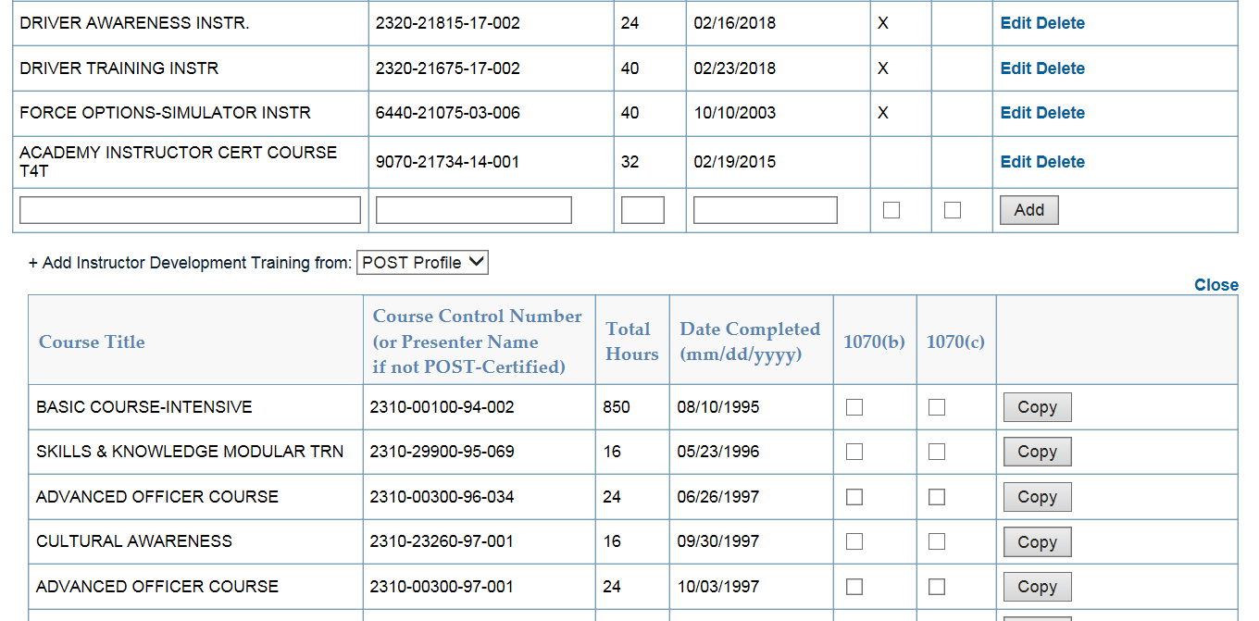
You can copy instructor courses from your POST Profile. ** Check 1070(b) for POST Specialized Instructor Training or 1070(c) for the equivalency. Once complete with this section, click on the blue “Return” tab to take you back to your resume page.
RESUME BUILDER
Completing Section 4

Slide 15
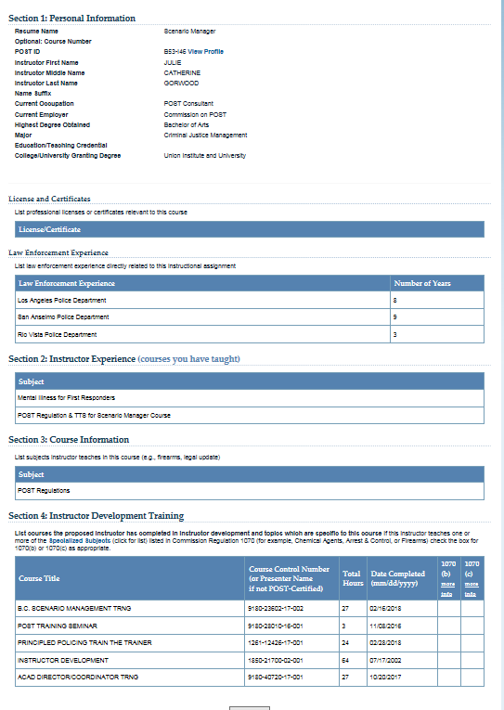
RESUME BUILDER
A completed Instructor resume will look like this, all 4 sections have been completed.

Slide 16
Step 5: Once you are done with the new resume, click on the drop down and change from “Draft” to “Ready” and click on “Submit.” This will take you to the next page where you can select which presenter to send your resume to.
RESUME BUILDER

Slide 17
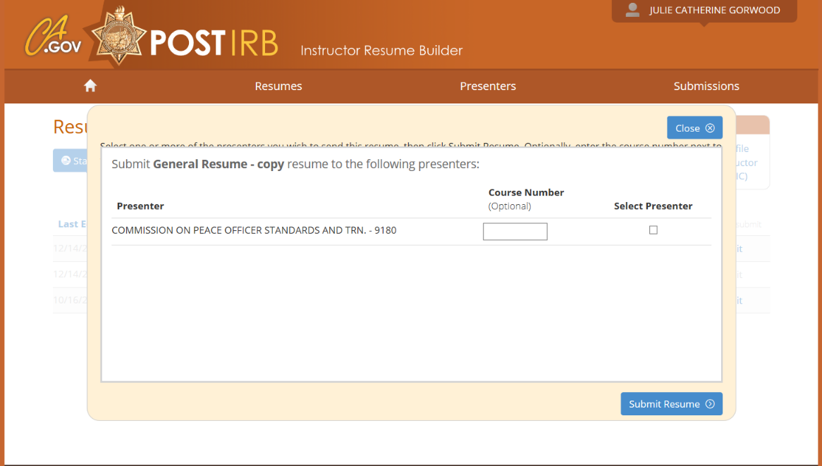
Step 6: Click the “Select Presenter” box for the presenter you wish the resume to go to, and then click on the blue “Submit Resume” button. * You must have already added the presenter to your list.
RESUME BUILDER

Slide 18
How to copy from your original instructor resume (Resume Builder) to create a new and different instructor resume. Step 1: Log into Instructor Resume Builder. Click on Resumes
RESUME BUILDER
How to copy resume

Slide 19
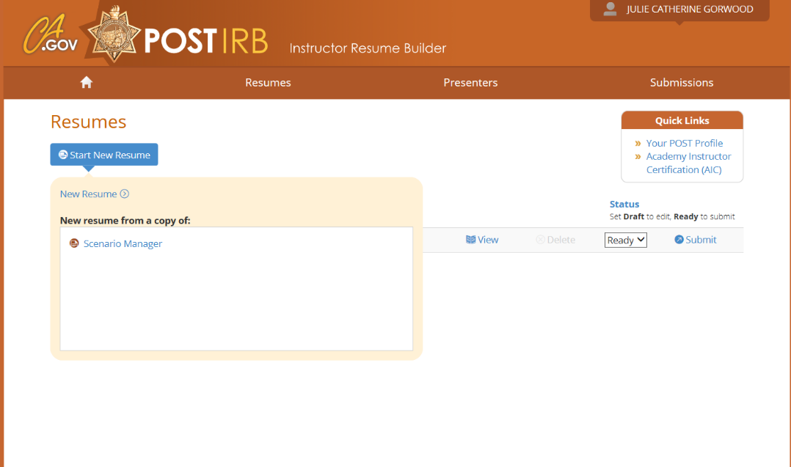
Step 2 Click on blue colored button “Start New Resume.” This will open a box in which you can select the resume you would like to copy from.
RESUME BUILDER

Slide 20
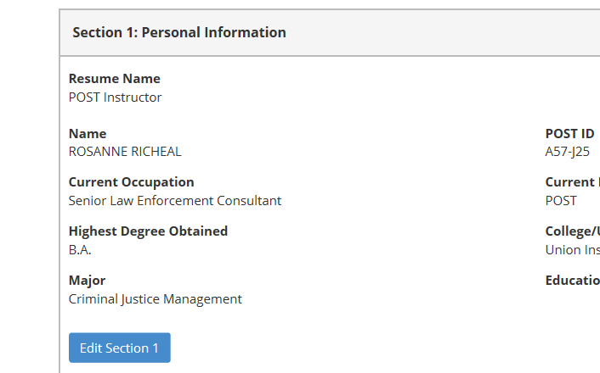
Step 3: Click on blue “Edit Section 1” button.
RESUME BUILDER
How to copy resume

Slide 21
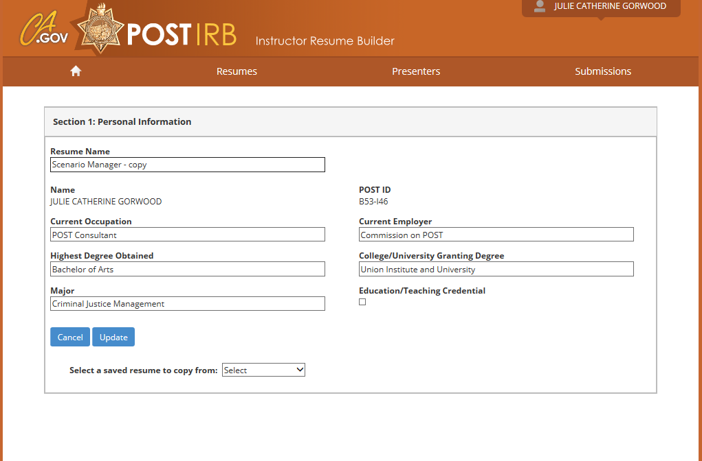
Step 3: In the “Resume Name” box, change the name of this new resume.
RESUME BUILDER
How to copy resume

Slide 22
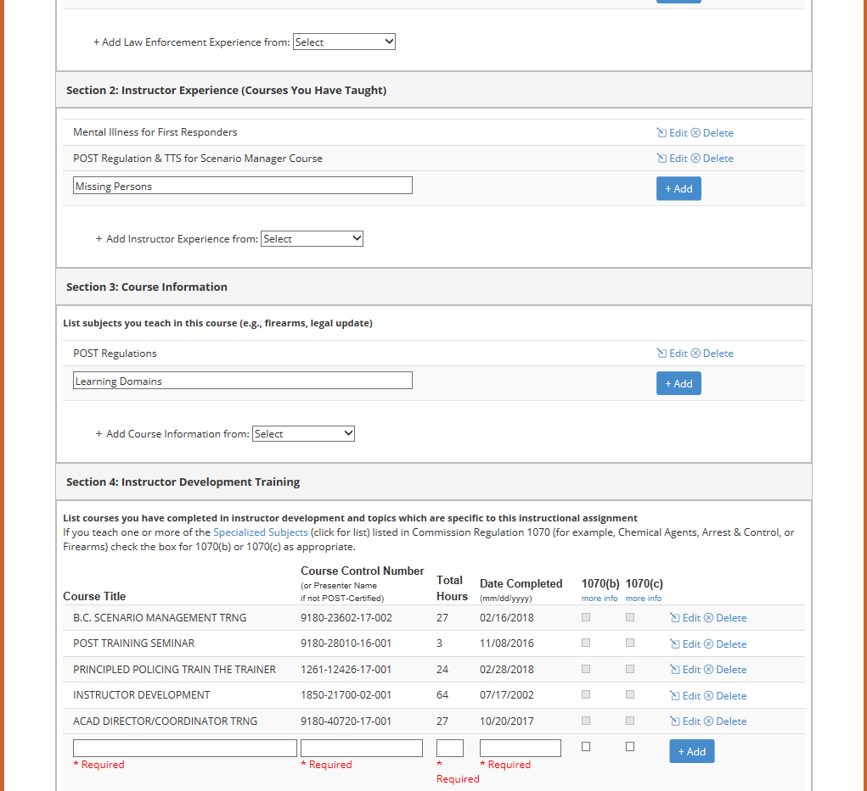
Step 4: You can “Edit” or “Delete” each section to tailor the resume to the course you are going to teach. Once you have made your changes, click the blue “Return” button at the bottom of the page.
RESUME BUILDER
LP

Slide 23
Any Questions on Resume Builder?

Slide 24
Step 1: Log into EDI. You can see if “You have new resumes” from instructors in the box for “General Quick Links.” You can access “Instructor Resume Manager” by clicking on the quick link or clicking on the “Courses” tab and selecting “Instructor Resume Manager.”
RESUME MANAGER

Slide 25
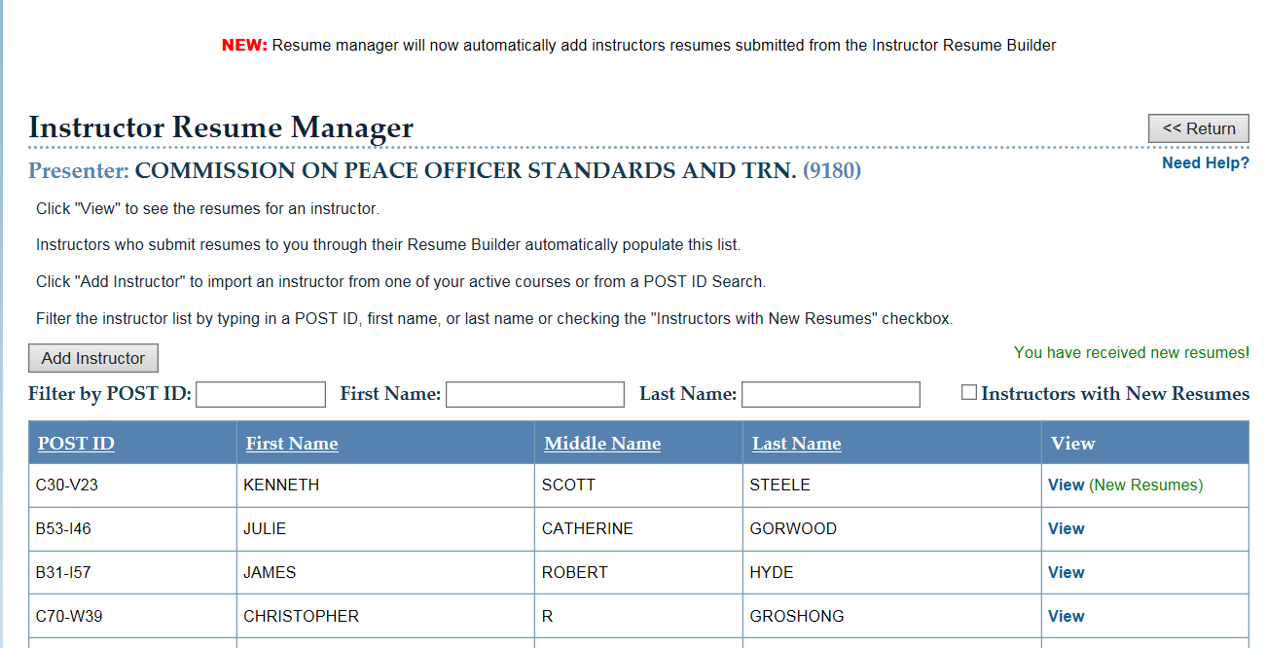
Step 2: When you open Resume Manager, it will show the list of instructor resumes you are managing. “New Resumes” are highlighted in green.
RESUME MANAGER

Slide 26
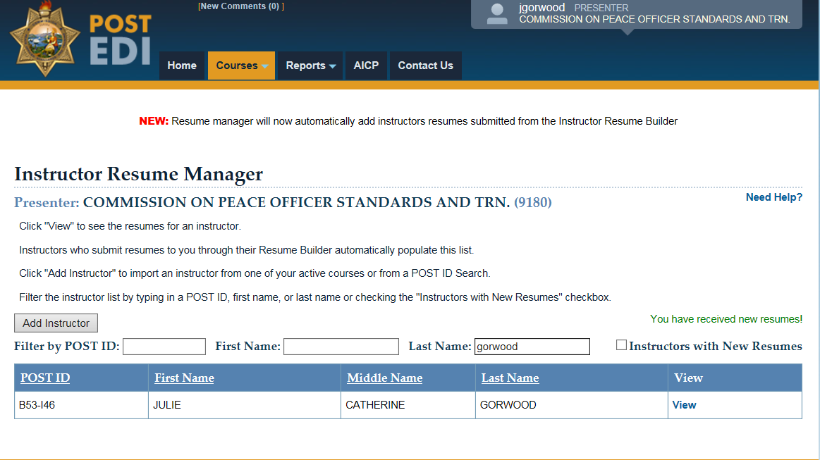
Step 3: There are several filtering search options. You can search for a specific resume by name.
RESUME MANAGER
Notes:
This feature is useful when you have dozens of resumes to sift through and just want to find the exact one

Slide 27
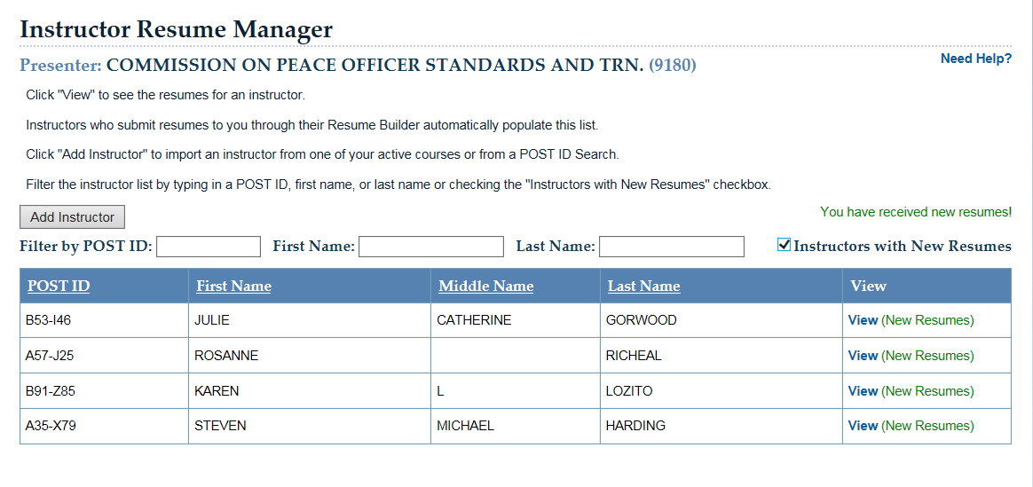
Step 4: You can click on the “Instructors with New Resumes” box to see only the new resumes you have received. You can edit, copy, archive before sending to a course.
RESUME MANAGER

Slide 28
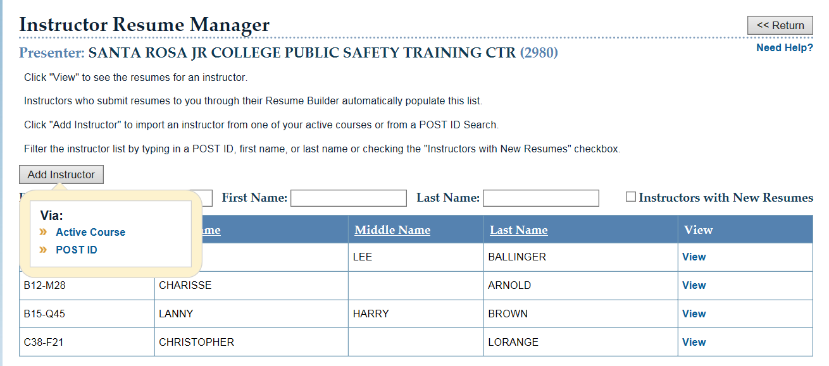
Click “Add Instructor” to import an instructor from one of your Active Courses or from a POST ID search.
RESUME MANAGER

Slide 29
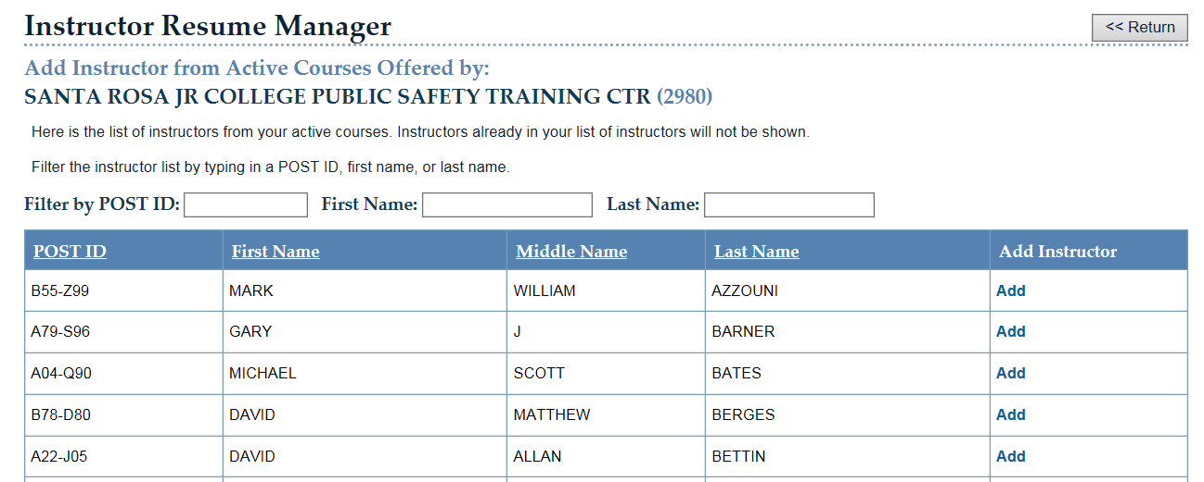
This slide shows a list of instructors in ACTIVE COURSES for SRJC. Instructors already on your Resume Manager list will not be shown on this list.

Slide 30
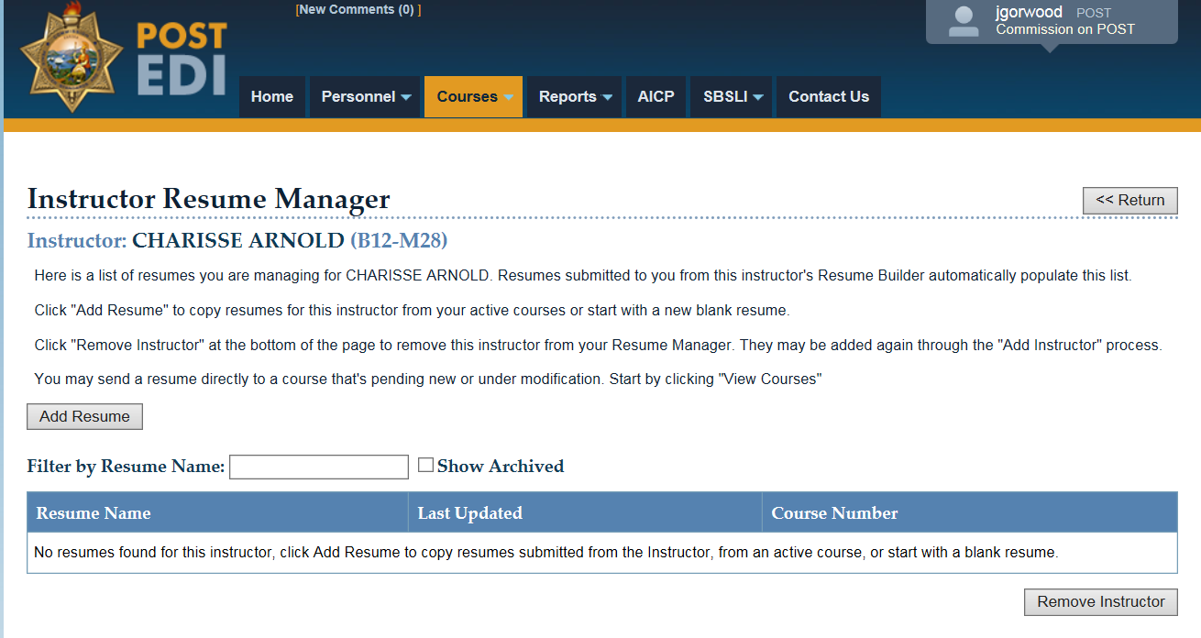
You will see the following message if you click on an instructor that has submitted a resume from Resume Builder
RESUME MANAGER
“No resumes found for this
instructor, click Add Resume
to copy resumes submitted from
the instructor, from an active course,
or start a blank resume.”
*Note-Here, you can Remove Instructor. This is the only place this will occur.

Slide 31
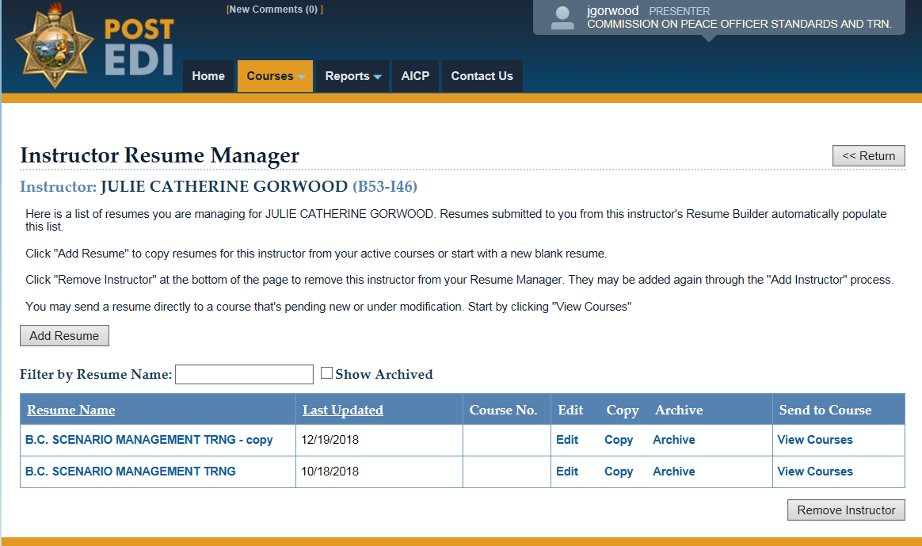
Step 5: When you click on “Copy”, it will create a duplicate copy of that instructor’s resume. Once you make a copy there is no function to delete it. All you can do is “Archive” it. If you click on “Remove Instructor”, it will delete the instructor resume from your presenter list. If you wish to add the instructor back into the course, go back to the main instructor list and select “Add Instructor.”
RESUME MANAGER

Slide 32
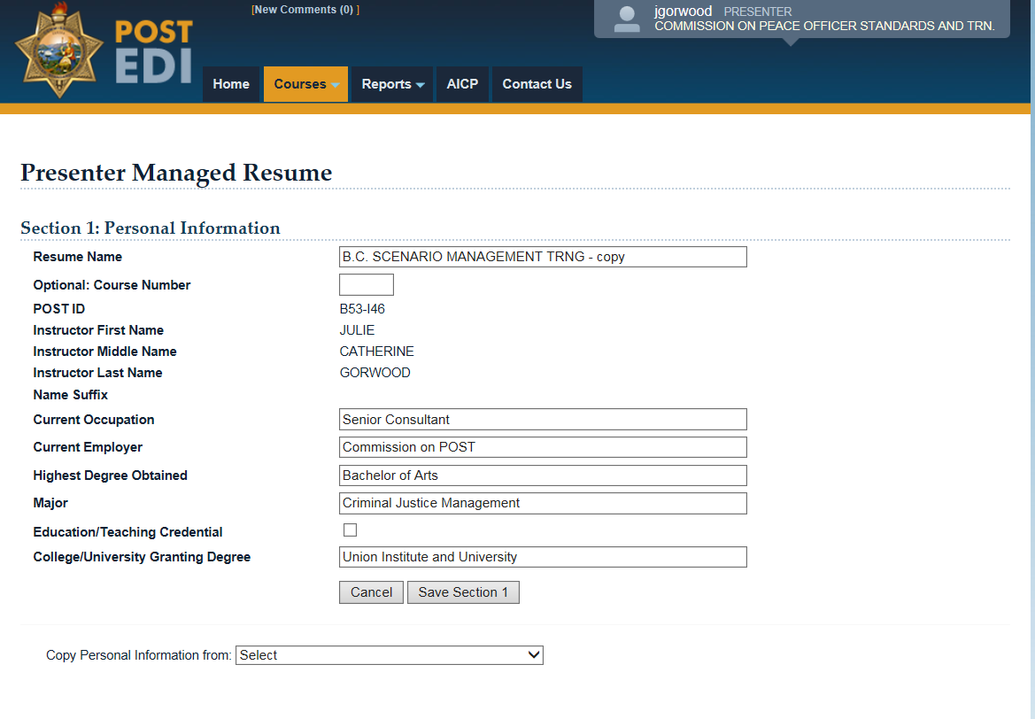
Step 6: From a copied instructor resume, you can create a new version of the resume and retitle it. *Once retitled continue through the resume and complete all remaining sections.
RESUME MANAGER
Change copied resume to new name
Notes:
As you will notice, once a master resume is built and in the system, you can copy from it or other resumes form that instructor

Slide 33
Step 7: Now that you have created a new resume (Module I), it will populate the resume to the list. Now click on “View Courses” tab which will give you the list of courses and select Module I.
Notes:
As you will notice, once a master resume is built and in the system, you can copy from it or other resumes from that instructor. You can tailor the new resume to the course you want to send it too.

Slide 34
Send Resume to Course

Slide 35
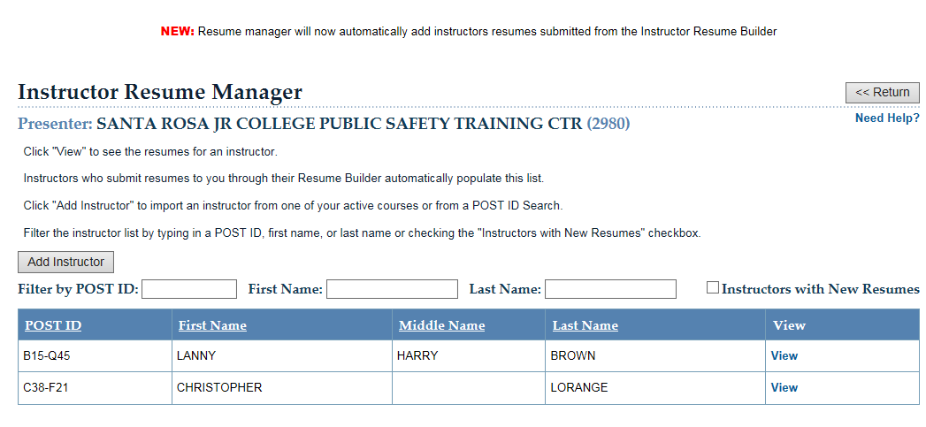
Send Resume To Course
RESUME MANAGER
From your list of Instructors, click on “View” to open up resume.

Slide 36
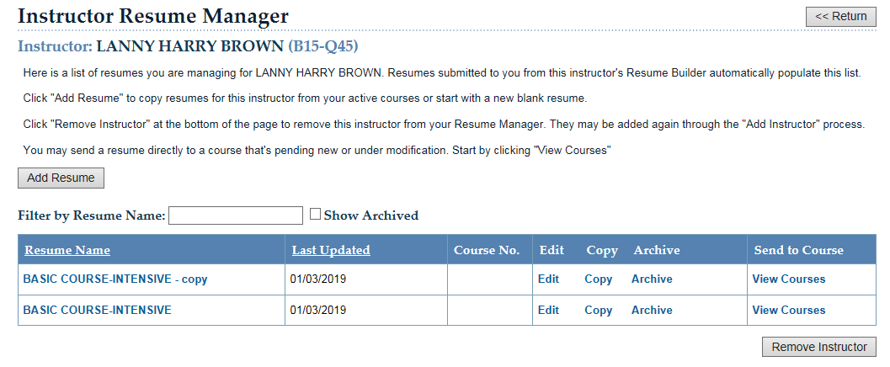
Looking at this list of resumes, select the resume you want to send to a course. Click on “View Courses”
RESUME MANAGER
*You can also copy resumes
for an instructor from your active
course or start a new blank resume.

Slide 37
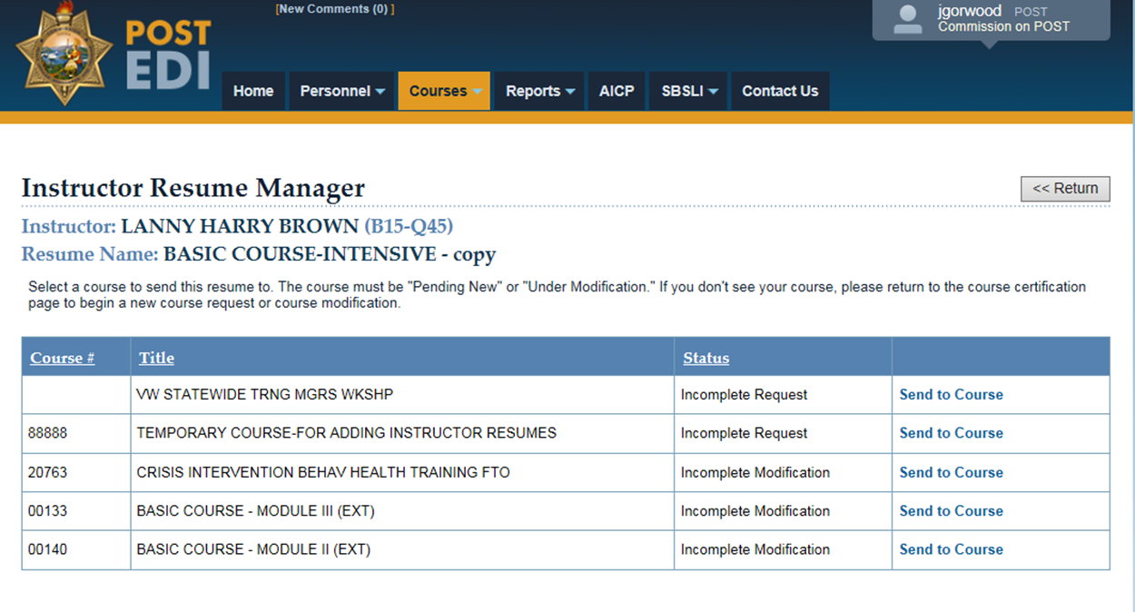
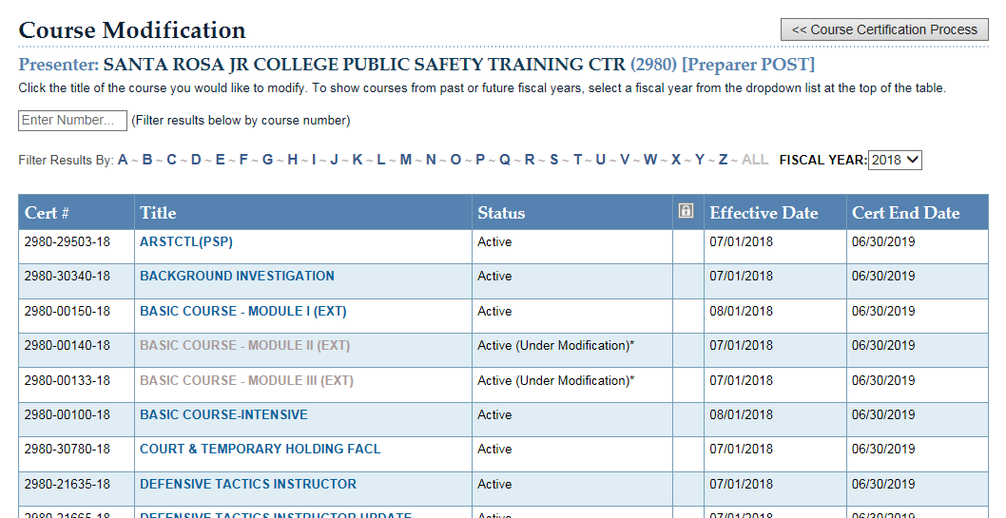
I am trying to send the resume to Defensive Tactics Instructor Course, why cannot I see it on my list?
RESUME MANAGER
In order to send a resume to a course, the course must be UNDER MODIFICATION. This is a failsafe since any changes to a course need to be in modification and approved by POST.

Slide 38
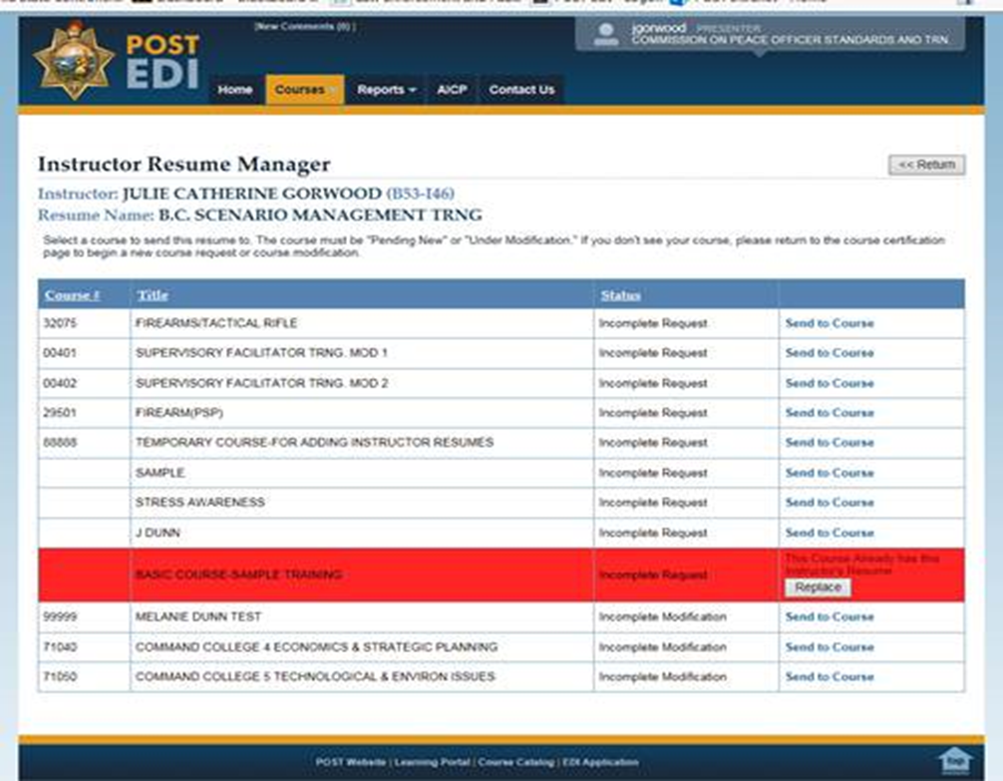
RESUME MANAGER
If you send an instructor resume to a course in which the instructor already is listed, it will flash RED. It will, if you want to, REPLACE the resume in the course with this version. If you do not want to replace the resume, click return on the top right corner of the screen.

Slide 39
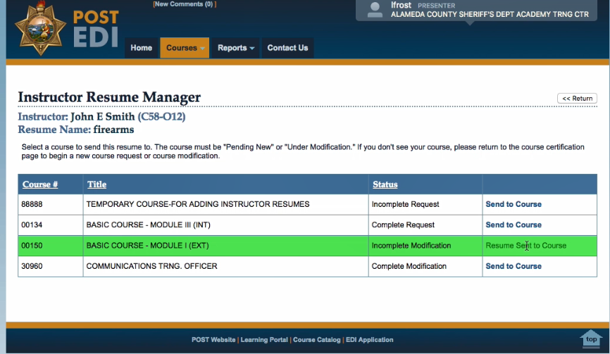
RESUME MANAGER
A green high-light will
appear once a resume
is successfully sent to a course.

Slide 40
Changing a Resume Approver
Notes:
As you will notice, once a master resume is built and in the system, you can copy from it or other resumes from that instructor. You can tailor the new resume to the course you want to send it too.

Slide 41
Go to EDI and select “Modify a Course” and select the course you want to edit the instructor resume.
RESUME MANAGER

Slide 42
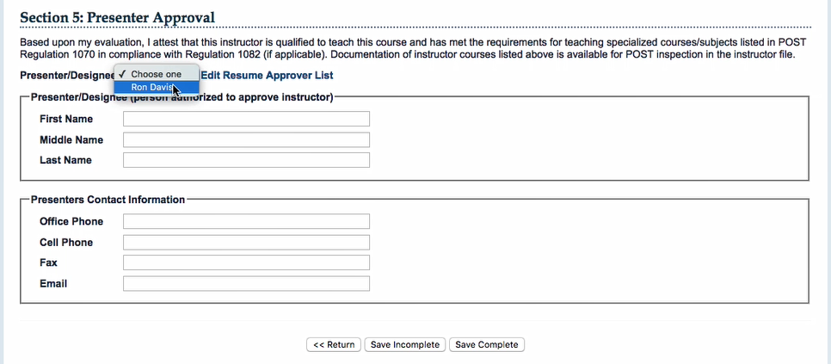
RESUME MANAGER
When you are ready to approve a resume, you can select from the drop down list. Once the name is selected it will auto- populate the information in the box.

Slide 43
You can edit the Roster Coordinator or Resume Approver list. Note: When you have a change in staff, make sure to update this list.
RC: Roster Coordinator
RA: Resume Approver

Slide 44
Don’t forget to select “Copy to Course” to send resume to the course you wish it to go to. If you make changes to a resume in MANAGER, it does not automatically change all other resumes. You have to manually send it to the course.

Slide 45
Accepting Updated Resume * An instructor can send an updated resume to you and it will show in your presenter list. * Accepting a new resume and sending it to the course will replace the old resume with the new version. *Always review instructor resumes for completeness and relevancy. * Double check boxes for 1070 (b) and (c).
HELPFUL REMINDERS
Notes:
It is the presenter’s responsibility to maintain records for 1070(c) to confirm equivalency

Slide 46
THANK YOU!

